Slide 1
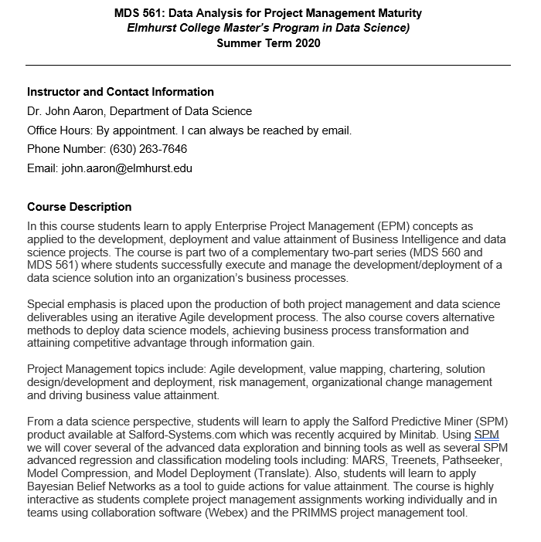

Slide 2
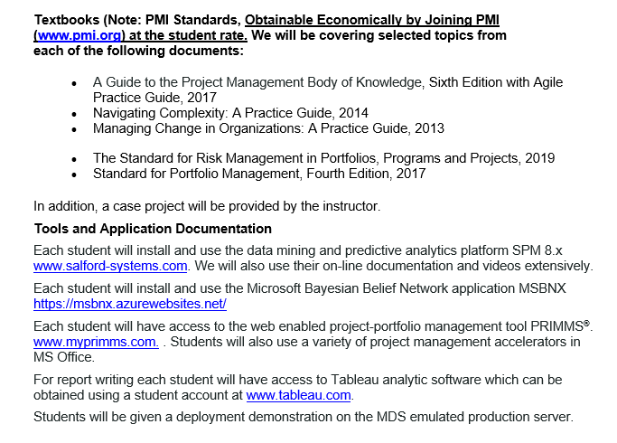

Slide 3
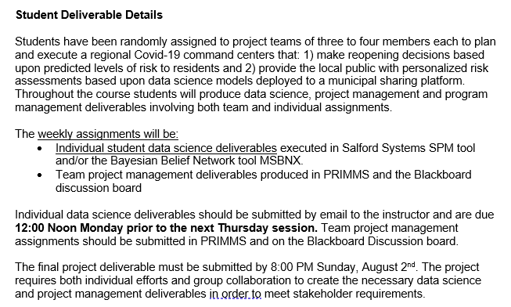
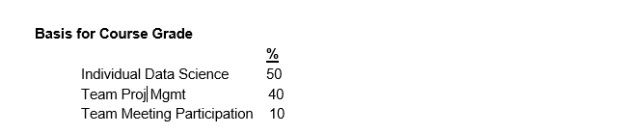

Slide 4
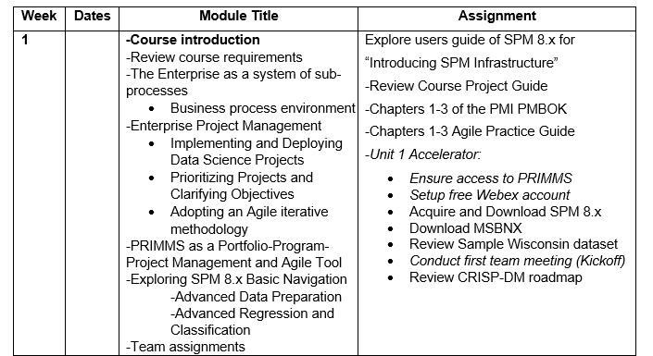

Slide 5
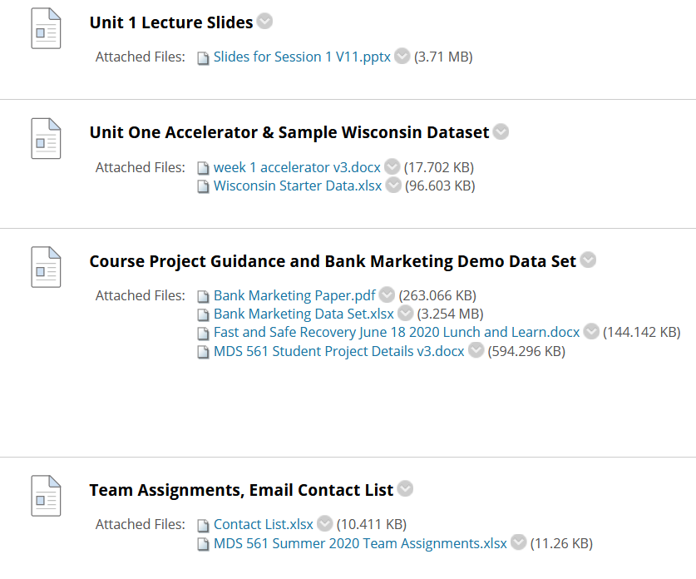

Slide 6
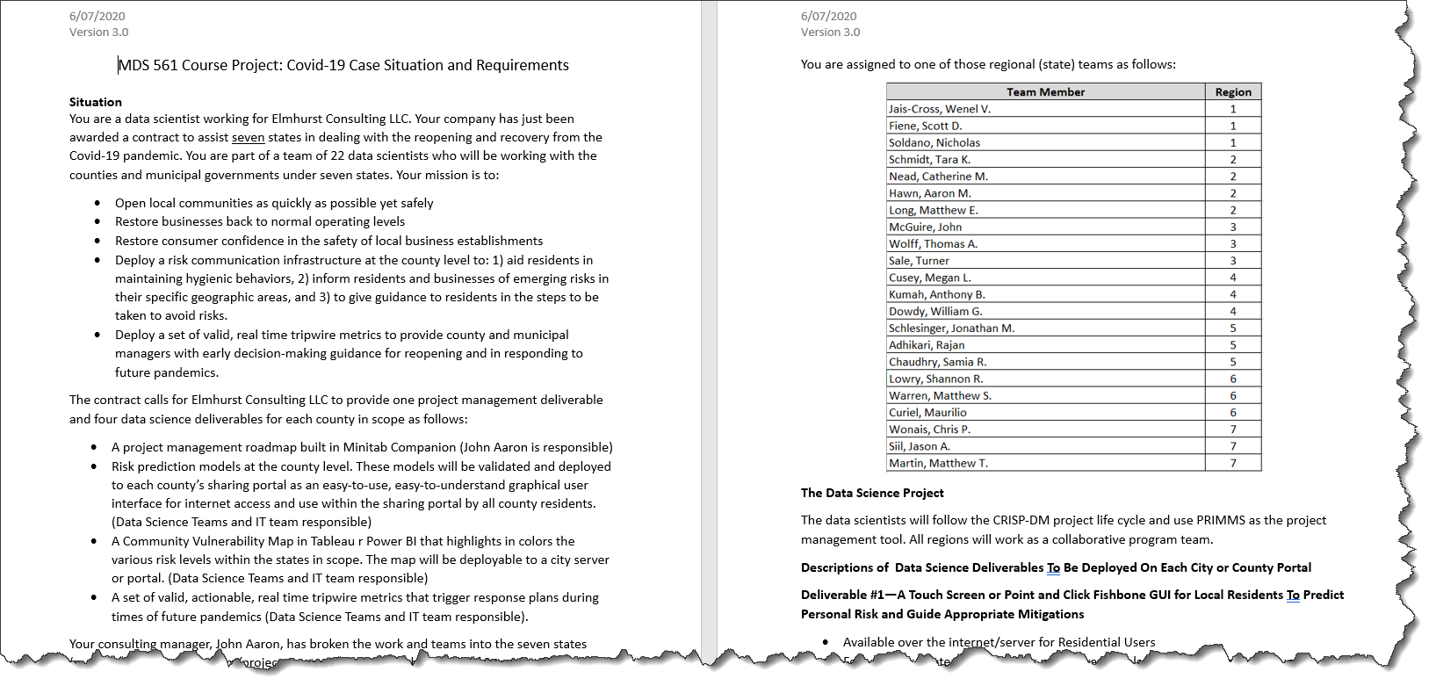
Course Project Guidance Part 1

Slide 7
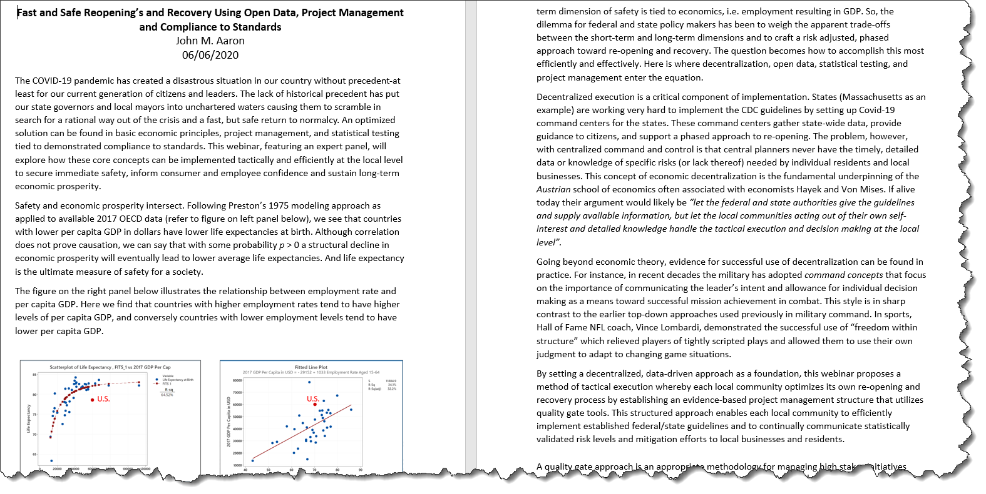
Course Project Guidance Part 2

Slide 8
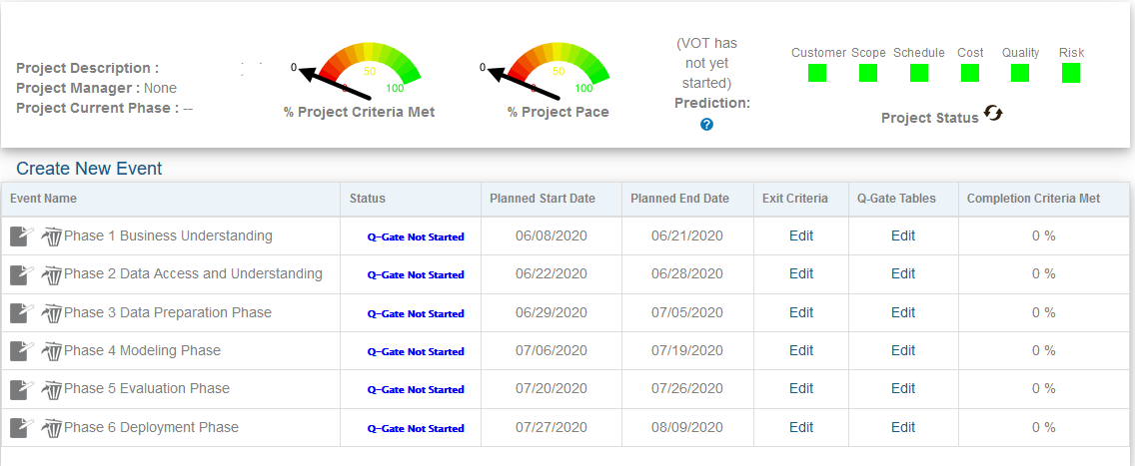
Course Project Guidance Part 3
Seven Programs, and Three to Four Separate State Projects Per Program
Ideally Different States Across Programs.
Each Student Manages a Specific State Covering all Counties in the State.
Objective: Development and Deployment of Data Science Deliverables.

Slide 9
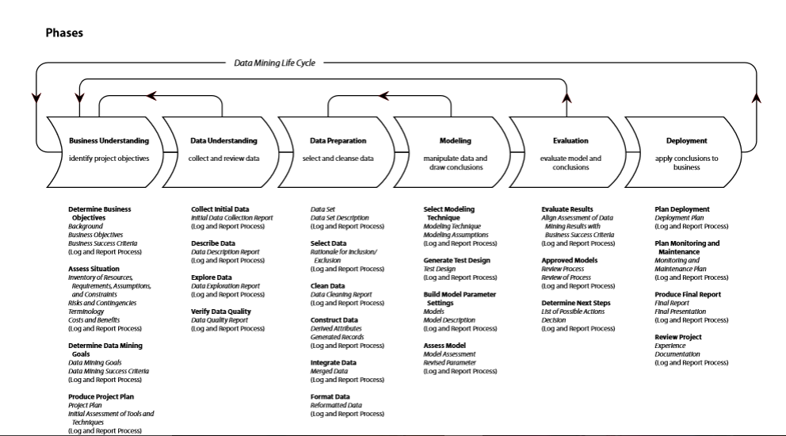
A Revised CRISP-DM Project Methodology with Deliverables
Test Enhanced Model
#3
Deploy To Production
#4
Baseline Model
#1
Enhanced Model; Create and Deploy Workbooks
#2
Post Project Monitoring
Project Charter, Value Map and Requirements
Baseline Project Schedule
Business Sign-off and Project Authorization. Scope Change Control
First Prototype Completed in Dev Environment
Weekly Risk Management Survey—VOT Begins
Issues and Gaps Documented
Phase Exit Review Completed
Weekly Status Begins
Community-Social Media Begins
Deploy Model to PRD
Load/Validate PRD Data
Go Live in PRD
Stabilization
System monitoring
Model Updates
Value Monitoring and
Management
Community Social Media Continues
Second Prototype Completed in Dev Environment
Future State Process Developed with ETL Data Modeled
Future State Process Documented
Schedule Updated
Issues and Defects Captured and Closed
Phase Exit Review Completed
Weekly VOT Continues
Weekly Status Continues
Community Social Media Continues
Third Prototype Created
Test Scripts Created
and Executed in QA
User Acceptance Testing
Completed with full data
Training Scripts Created
User Training Delivered
Issues and Defects Closed
Community Social Media
Continues for communication

Slide 10
Peirce’s Trichotomy of the Scientific Method
As Self-Correcting Cycles Leading to the “Truth”
Multiple
Hypotheses
Tied to K. Popper’s Falsifiability of Hypotheses
Abductive
Reasoning
Begin Next Cycle with Convergence on “Truth”
What are Testable Conclusions About Other Phenomenon That Must Be Reached For Each Hypothesis if True?
Controlled Experiments Based Upon Samples From a Population
Explanatory
Hypotheses
Experience
What Must
Happen If True?
Deductive
Reasoning
Begin Research
Assess Results of Application and Adjust Hypotheses
A Question or Problem
Sufficient Accuracy Reached to Take Action
Elimination
of False Hypotheses
(retroduction)
Test Predictive
Models
Execute Actions
reflects innovative use of results.
Inductive
Reasoning
Assess Accuracy
Economics Plays a Role in Sufficiency Decision.

Slide 11
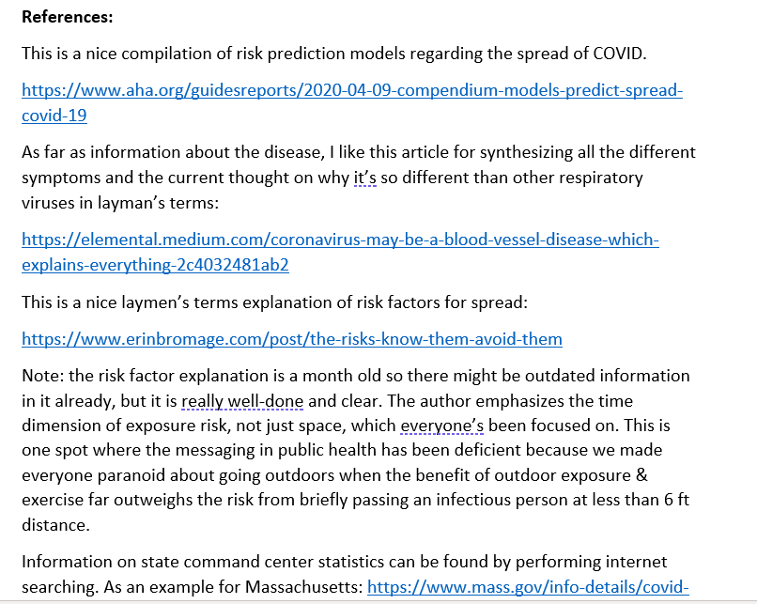
Where Do Hypotheses Come From?

Slide 12
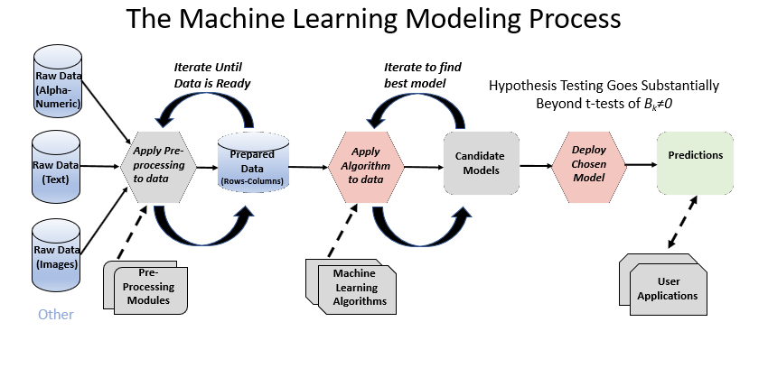

Slide 13
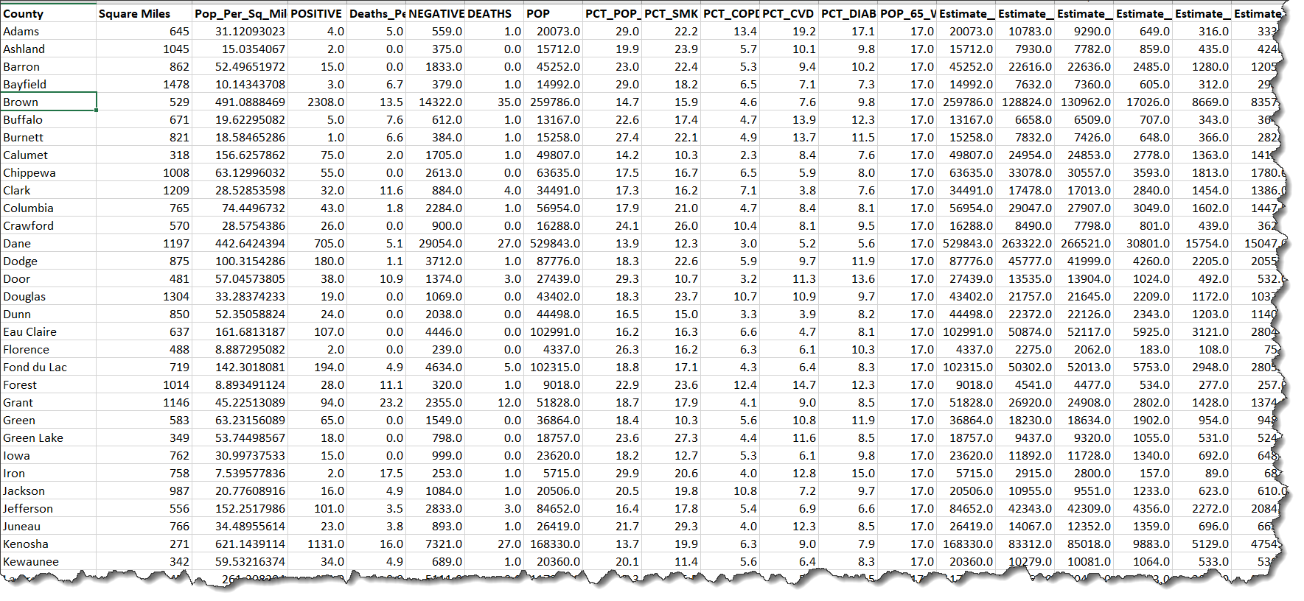
Data Sets Available From States Merged With Census Data
Example: Wisconsin Starter Data Set

Slide 14
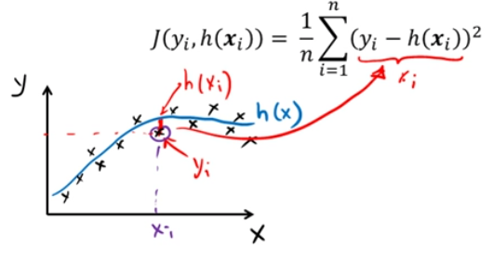
Modeling Provides Both Explanation and Prediction
Explanation is Tied to Hypothesis Testing
R² = 1-RSS/TSS
Y
1-RSS=ESS
Y
Average
Average
X
X
The typical least squares cost function

Slide 15
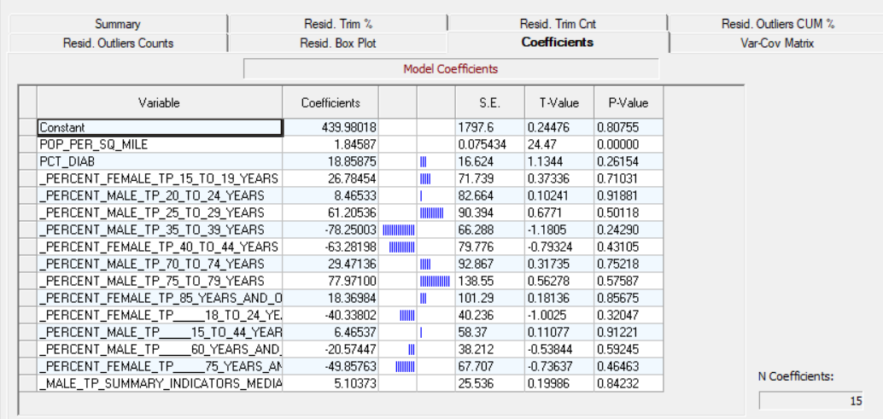
Explaining Total Positives: Tied To Population Density

Slide 16
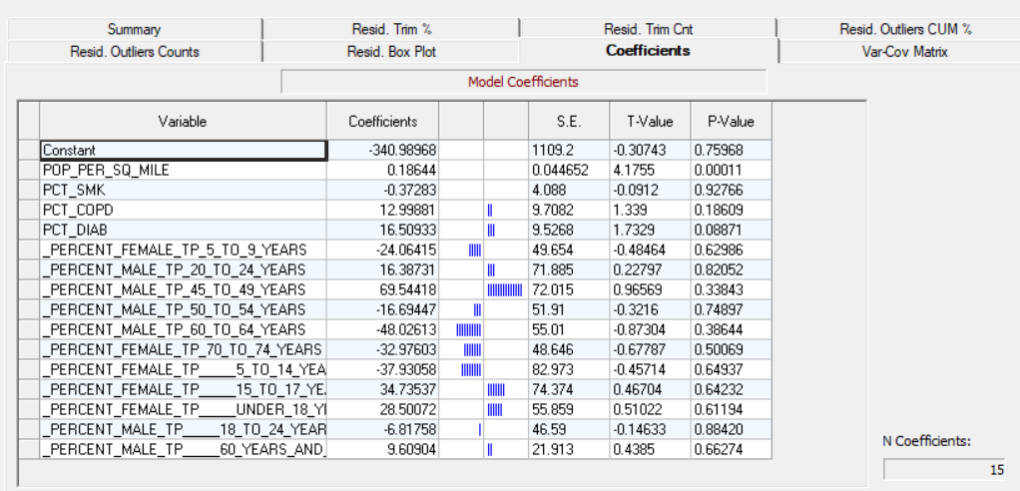
Explaining Total Positives Per 100k Population: Tied To Population Density And Diabetes

Slide 17
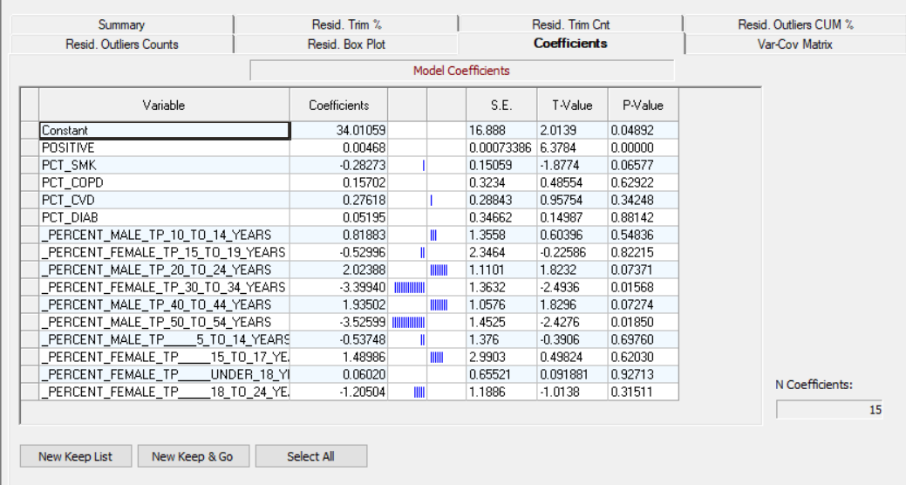
Explaining Deaths Per 100k Population Across Wisconsin Counties Using Regression

Slide 18
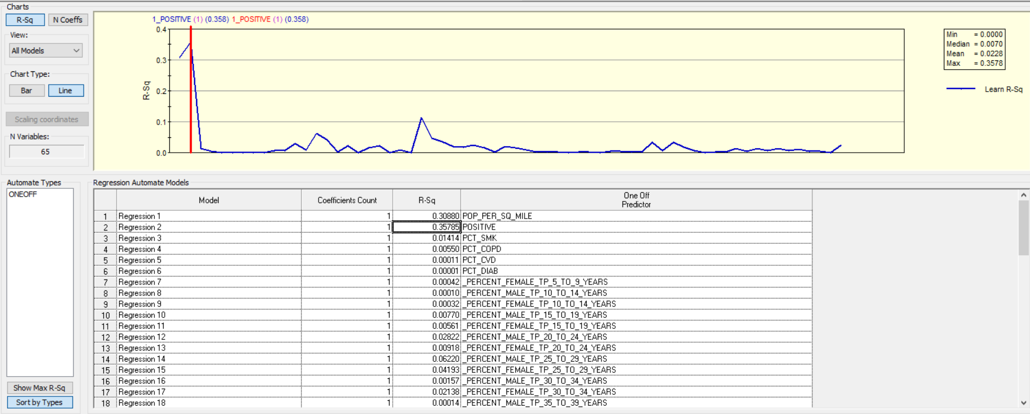
Several Variables Stand Out As Explaining Death Rates
Using OneOff

Slide 19
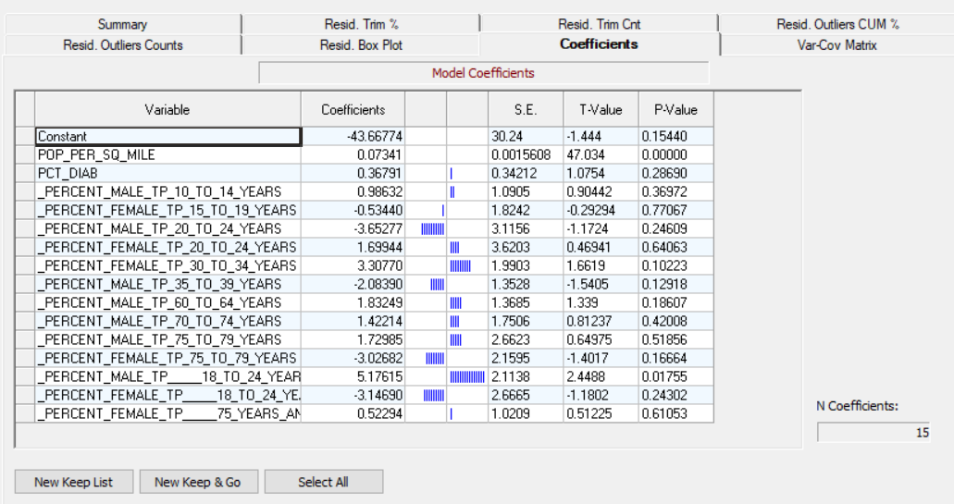
Explaining Deaths Is Tied to Population Density

Slide 20
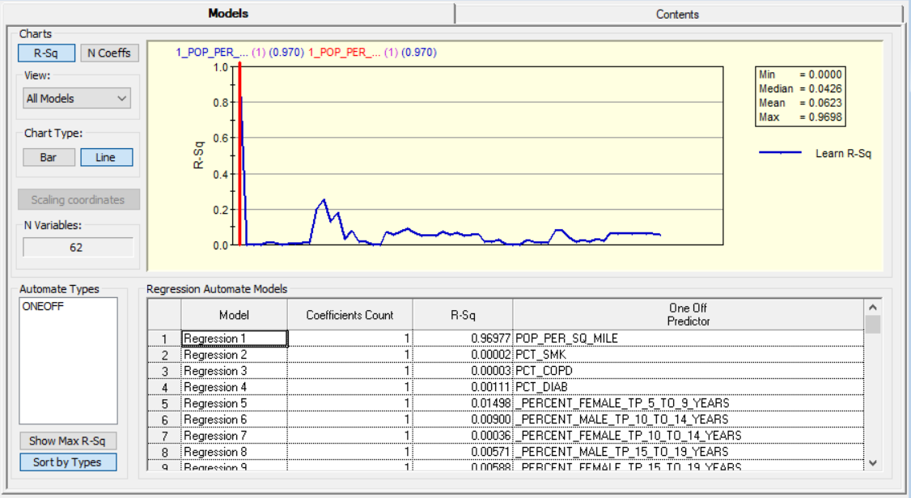
Explaining Deaths Is Tied to Population Density

Slide 21
These Preliminary Findings Lead the Customer To Believe That Separate Risk Mitigation Strategies Are Required for High Density and Low Density Areas
The Design of the Reopening Process Should Consider This

Slide 22
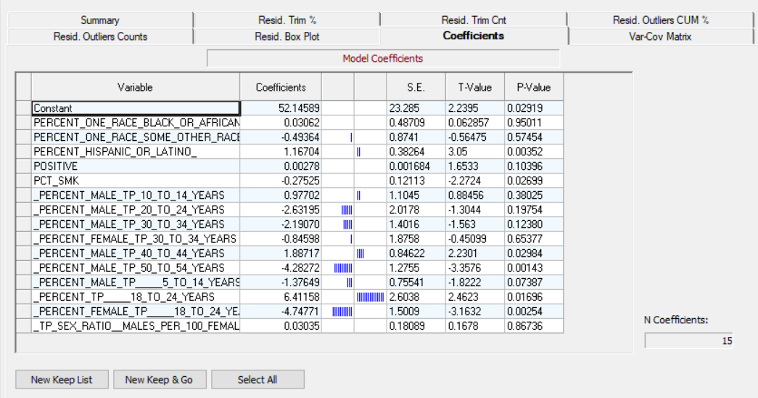
Next Week You Will Expand The Number of Explanatory Variables Toward Deaths Per 100k Population

Slide 23
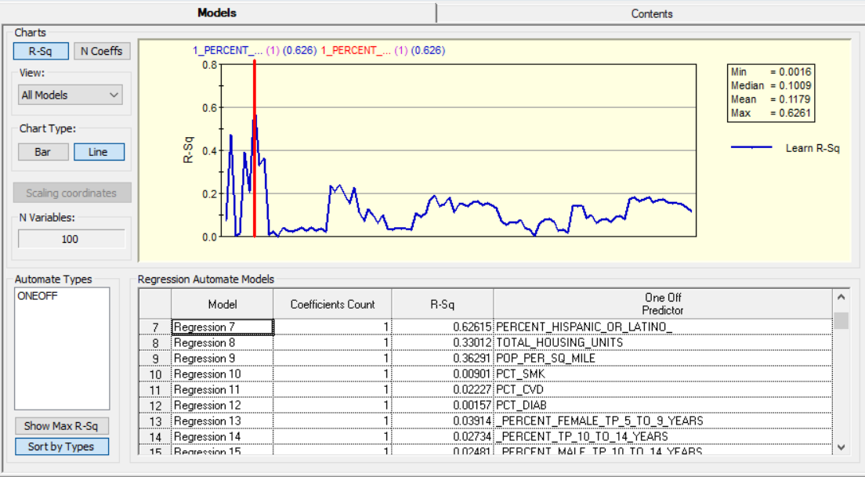
And Positives Per 100k Population

Slide 24
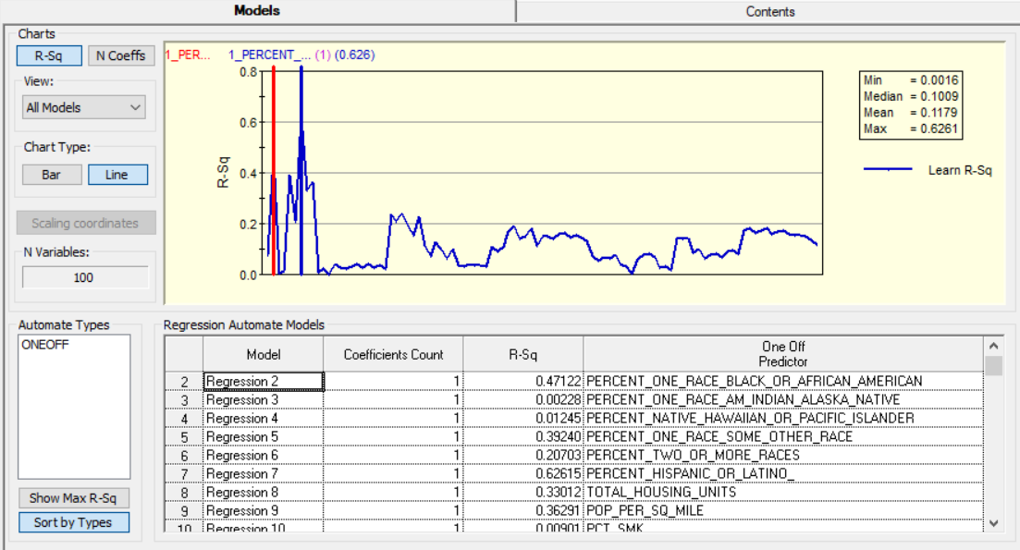
And Positives Per 100k Population(Continued)

Slide 25
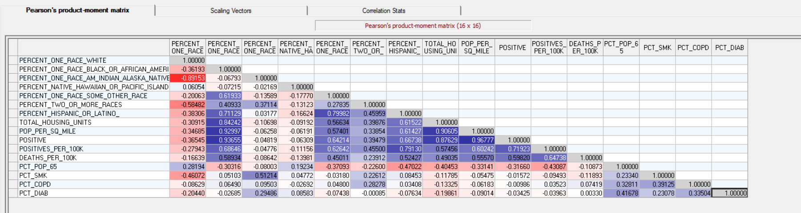
We Will Also Explore Topic of Correlation Versus Causation
For Example: Some New Stories Have Headlined Research Findings Suggesting That Minorities Or More Vulnerable To The Virus. But Look at the Correlation With a Third Variable Related to Population Density…Housing Units and Population per 100k.

Slide 26
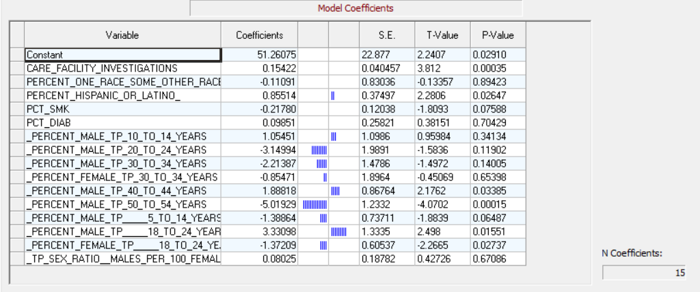
The Perspective Changes As You Add Variables

Slide 27
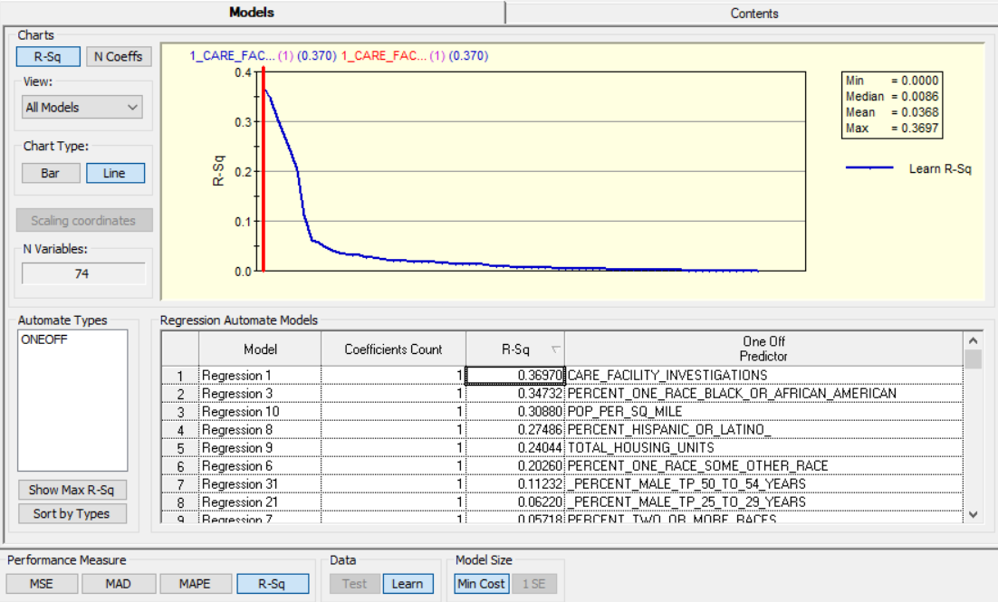

Slide 28
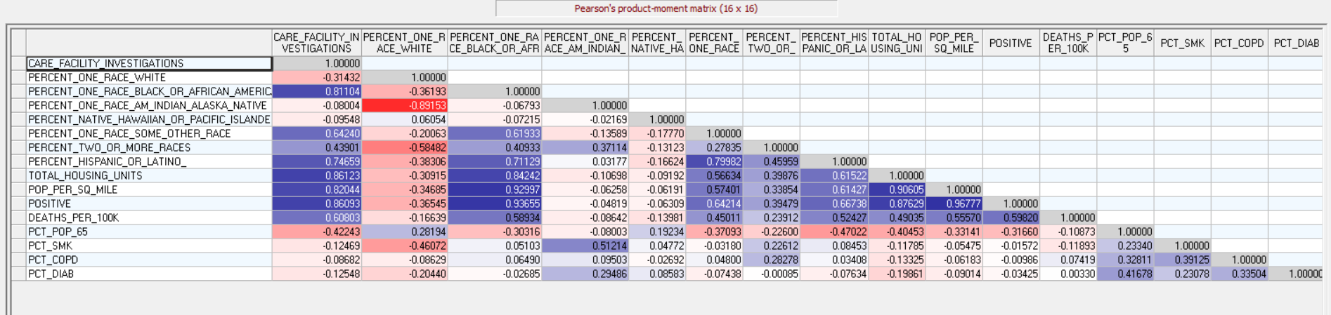
Correlation Versus Causation

Slide 29
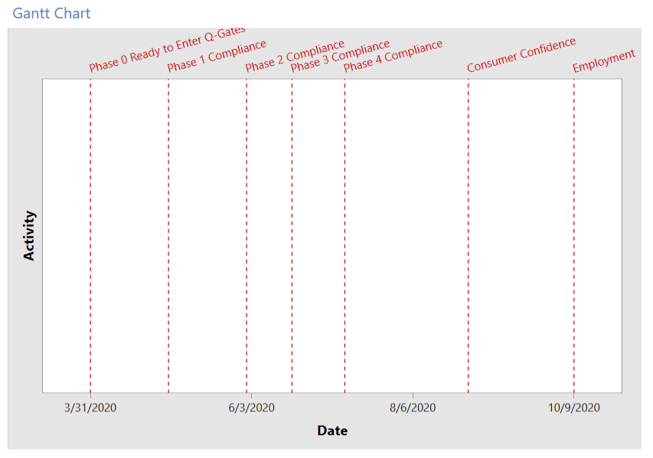
CDC Gate Criteria Tied to Statistical Tests of Actual Mortality Versus Normal Expected Mortality For An Area
Statistical Trigger
Risk Elimination, Avoidance and Mitigation Steps
Anchored in Safety and Sufficiency Criteria
Jenn’s Slide

Slide 30
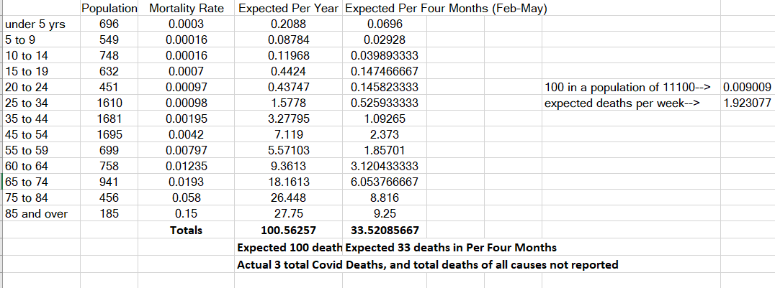

Slide 31
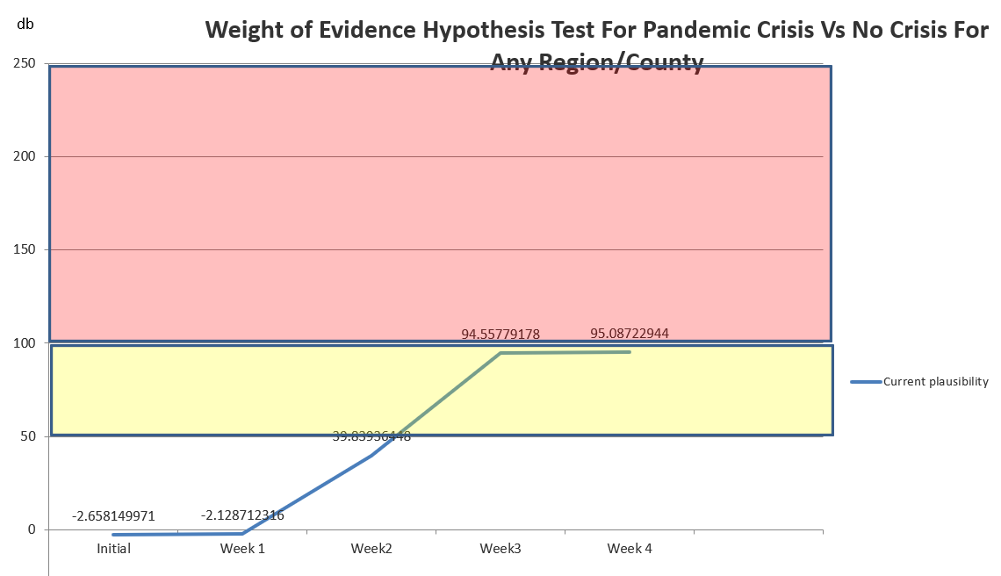

Slide 32
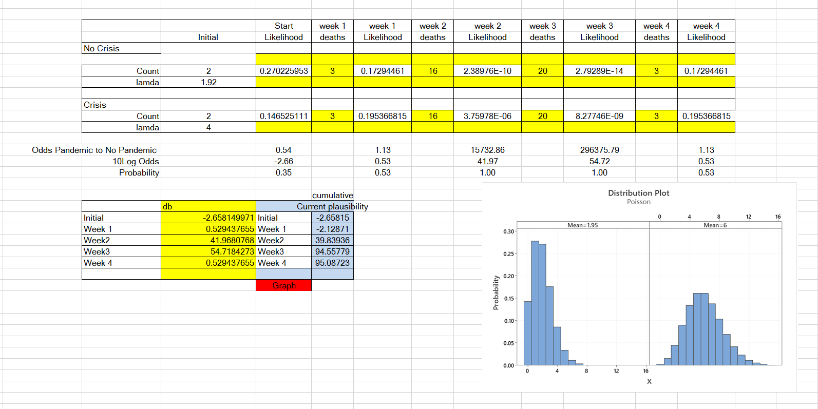
The Tripwire Framework Using a Bayesian Methodology

Slide 33
Peirce’s Trichotomy of the Scientific Method
As Self Correcting Cycles Leading to the “Truth”
Multiple
Hypotheses
Abductive
Reasoning
Begin Next Cycle with Convergence on “Truth”
What are Testable Conclusions About Other Phenomenon That Must Be Reached For Each Hypothesis if True?
Controlled Experiments Based Upon Samples From a Population
Explanatory
Hypotheses
Experience
What Must
Happen If True?
Deductive
Reasoning
Begin Research
Assess Results of Application and Adjust Hypotheses
A Question or Problem
Sufficient Accuracy Reached to Take Action
Elimination
of False Hypotheses
(retroduction)
Test Predictive
Models
Execute Actions
reflects innovative interpretation of results.
Inductive
Reasoning
Assess Accuracy
Economics Plays a Role in Sufficiency Decision.

Slide 34
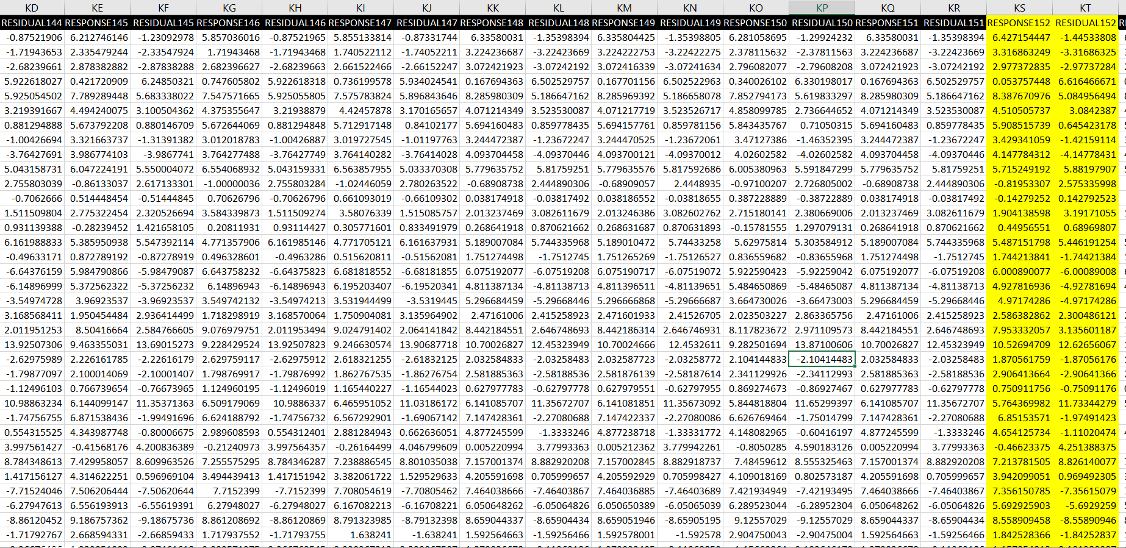
Prediction From Risk Models Is Uncertain Due to Poor Test Performance. This Needs To Be Improved If Possible

Slide 35
Your First Weekly Team Meeting
One team member signs up for a 30 day free trial of Webex www.webex.com and hosts the weekly meetings. Following the first 30 days another team member signs up for the second 30 day trial.
First team member on list invites fellow team members to attend recurring meetings (once per week)
During the meeting agree upon (at least tentatively) which states your program team will handle and which states each team member will own.
Add a project description to the project charter and scope statement. Migrate the charter to the PRIMMS Document Repository.
Team members start their projects and updates status in PRIMMS.
Each team member will complete the accelerator assignment individually and email to the instructor.

Slide 36
Peirce’s Trichotomy of the Scientific Method
As Self Correcting Cycles Leading to the “Truth”
Multiple
Hypotheses
Abductive
Reasoning
Begin Next Cycle with Convergence on “Truth”
What are Testable Conclusions About Other Phenomenon That Must Be Reached For Each Hypothesis if True?
Controlled Experiments Based Upon Samples From a Population
Explanatory
Hypotheses
Experience
What Must
Happen If True?
Deductive
Reasoning
Begin Research
Assess Results of Application and Adjust Hypotheses
A Question or Problem
Sufficient Accuracy Reached to Take Action
Elimination
of False Hypotheses
(retroduction)
Test Predictive
Models
Execute Actions
reflects innovative interpretation of results.
Inductive
Reasoning
Assess Accuracy
Economics Plays a Role in Sufficiency Decision.

Slide 37
A Revised CRISP-DM Project Methodology with Deliverables
Post Project Monitoring
Project Charter, Value Map and Requirements
Baseline Project Schedule
Business Sign-off and Project Authorization. Scope Change Control
First Baseline Prototype Completed in Dev Environment
Weekly Risk Management Survey—VOT Begins
Issues and Gaps Documented
Phase Exit Review Completed
Weekly Status Begins
Community-Social Media Begins
Deploy Model to PRD
Load/Validate PRD Data
Go Live in PRD
Stabilization
System monitoring
Model Updates
Value Monitoring and
Management
Community Social Media Continues
Second Prototype Completed in Dev Environment
Future State Process Developed with ETL Data Modeled
Future State Process Documented
Schedule Updated
Issues and Defects Captured and Closed
Phase Exit Review Completed
Weekly VOT Continues
Weekly Status Continues
Community Social Media Continues
Third Prototype Created
Test Scripts Created
and Executed in QA
User Acceptance Testing
Completed with full data
Training Scripts Created
User Training Delivered
Issues and Defects Closed
Community Social Media
Continues for communication

Slide 38
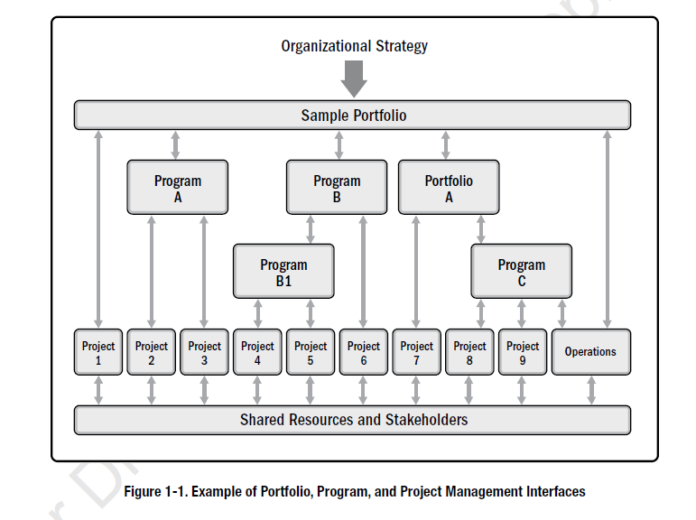
The PMBOK Standard

Slide 39
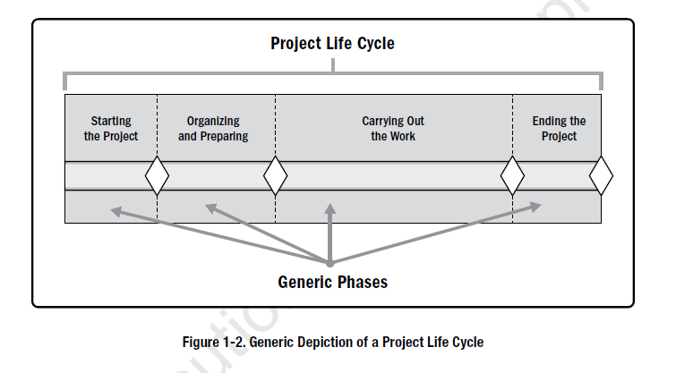
The Cornerstone Concept of Project Management is Managing Through Influence

Slide 40
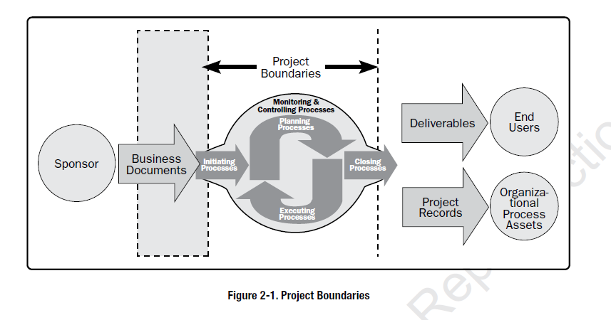

Slide 41
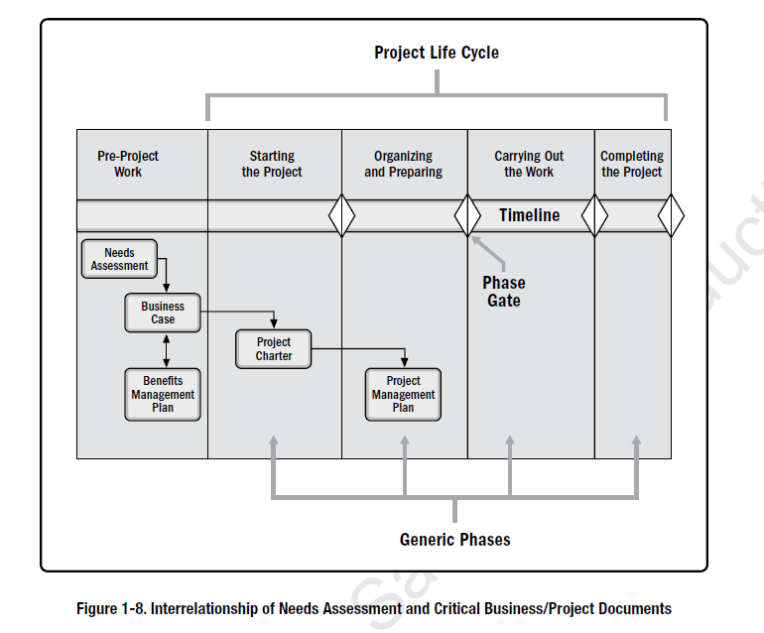

Slide 42
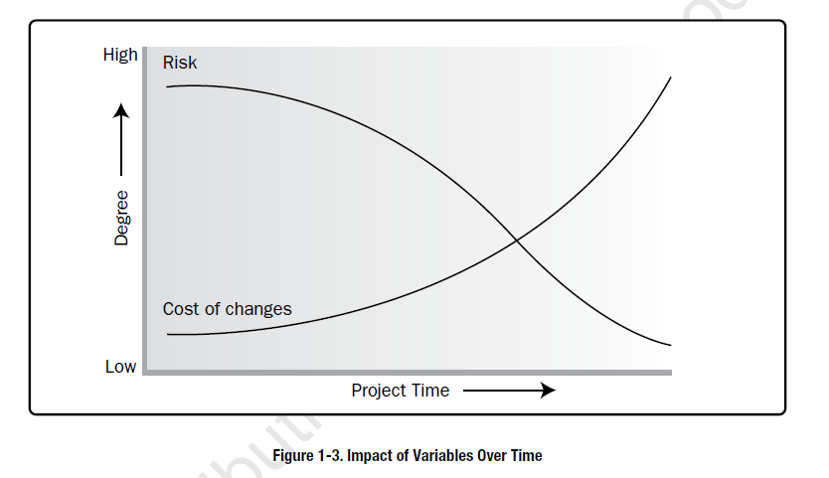

Slide 43
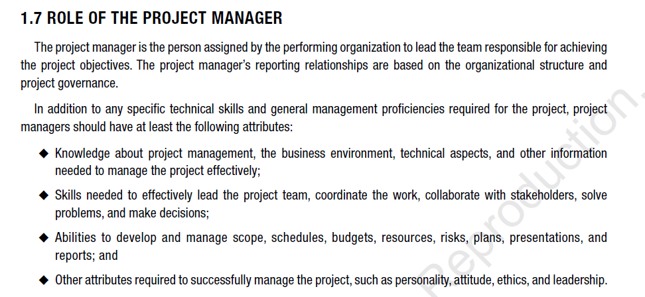

Slide 44
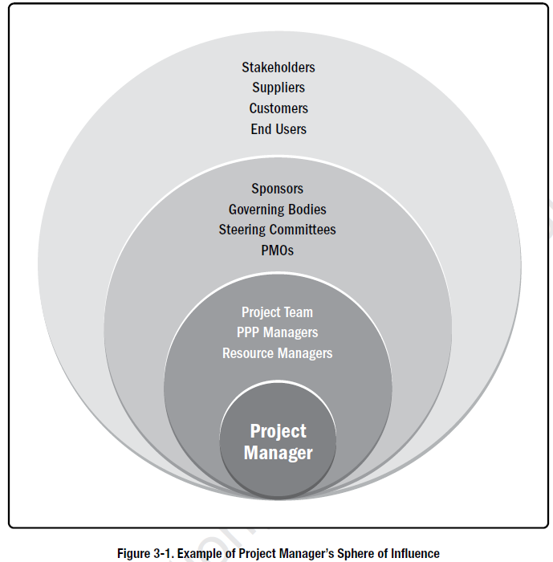
Project Deliverables Make the Organization More Competitive
You as Multiple Teams
John A. as Portfolio Mgr.
John A as Sponsor.
You as a Team
Each of You

Slide 45
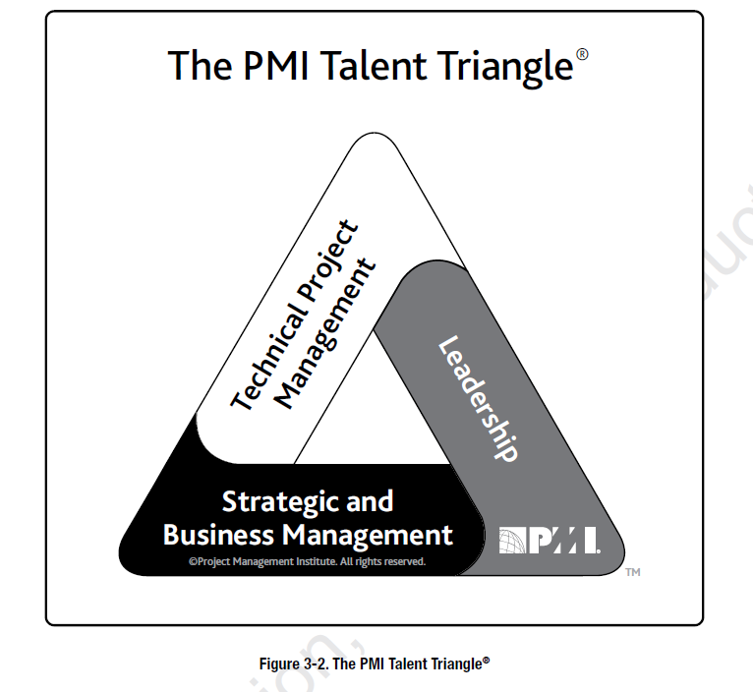

Slide 46
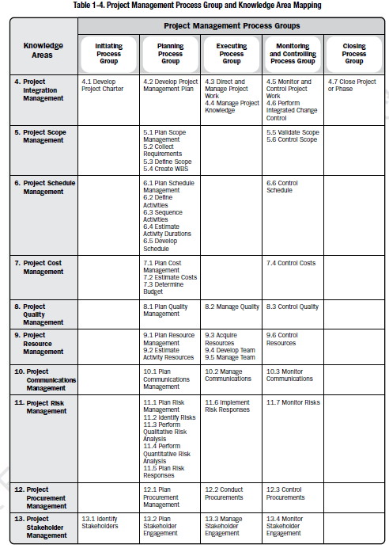

Slide 47
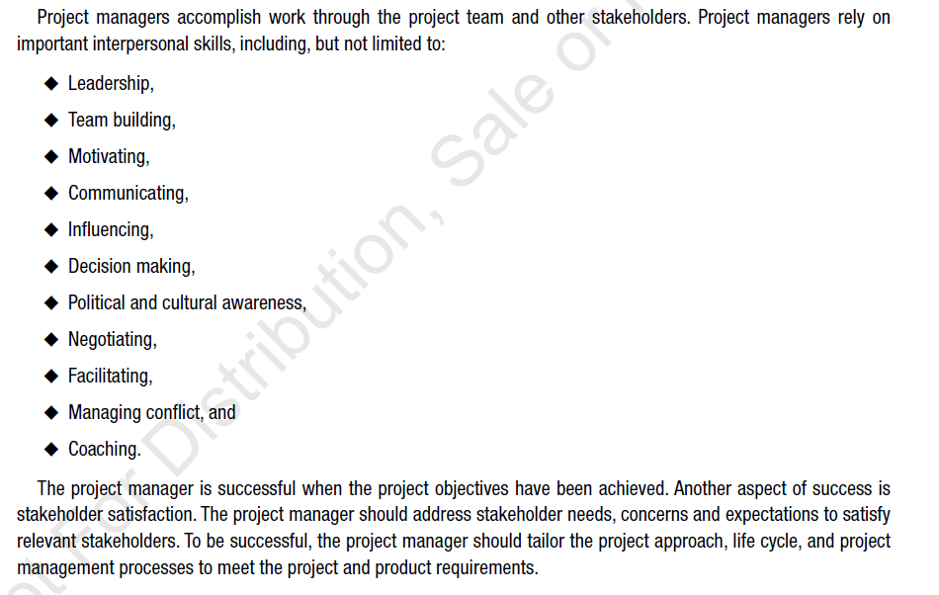

Slide 48
A Useful Structure For Planning and Controlling Technical Projects
Phase or Cycle 1
Phase or Cycle 2
Phase or Cycle 3
Phase or Cycle 4
Project Manager’s Purview
Business Team
Internal Development
External Development
Data Science
Vendors
Vendors
Other Teams
and Systems
Exit Criteria
Exit Criteria
Exit Criteria
Phase Transition Gates
Time

Slide 49
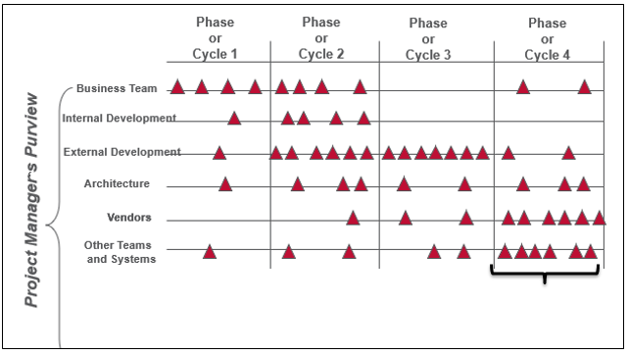
Events in a Waterfall or Agile Project Life Cycle
PRIMMS Structure
Events
Key Deliverables
Data Science
Work Streams
Quality and Completion Criteria

Slide 50
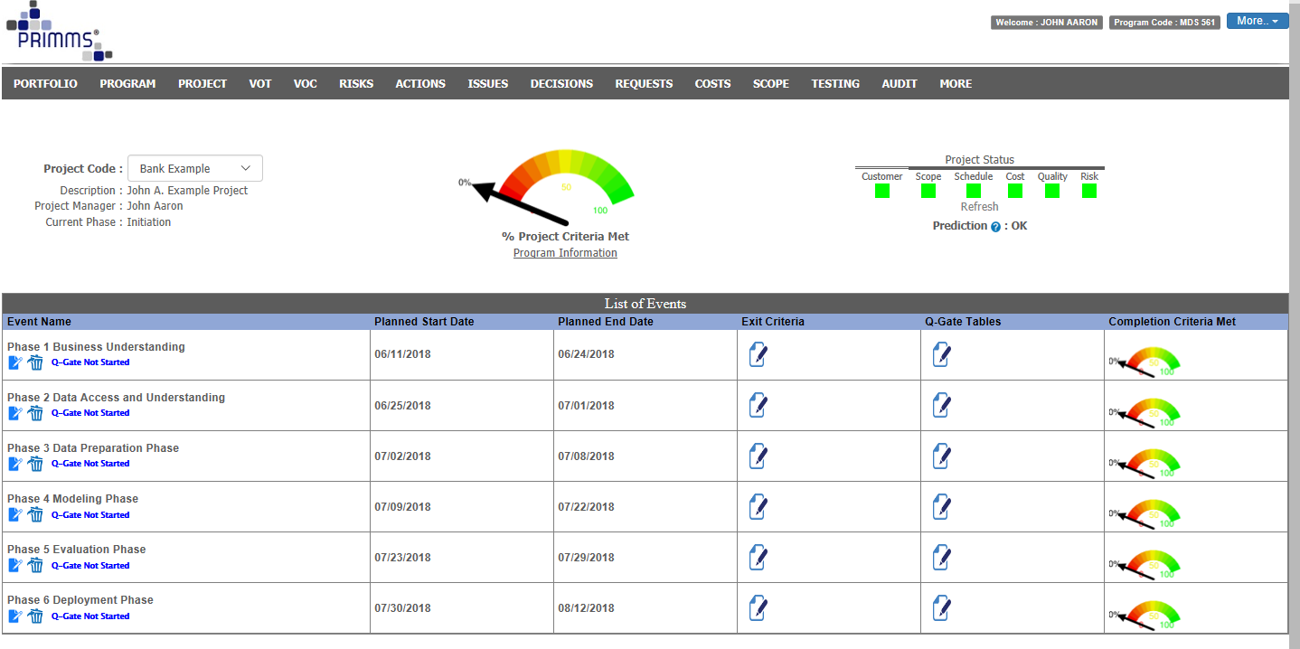
Examples of Events in PRIMMS
Notes:
Add this as a hint: Project Schedules / WBS:

Slide 51
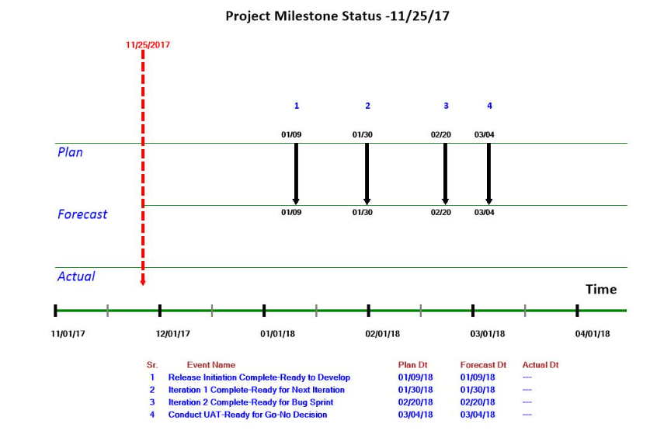
Slip Chart
The Slip Chart helps communicate Integrated Schedule and Quality status

Slide 52
Session 5: Quality Gates
Session Objectives
Define and maintain Exit Criteria
Define and maintain Quality Gates
Define and maintain Deliverables
Demo / Real Life Example
Exercises
Maintain Exit Criteria for an Event
Maintain Quality Gates for and Event
Maintain Deliverables for an Event
A Quality Gate* is a set of completion criteria and sufficiency standards that, upon attainment, constitute event completion. Quality Gates are particularly important for making Event Go-No Go Decisions for authorizing a team to move forward toward a next event.
*Historically PMI’s PMBOK has referred to these as Phase Gates and Stage Gates.

Slide 53
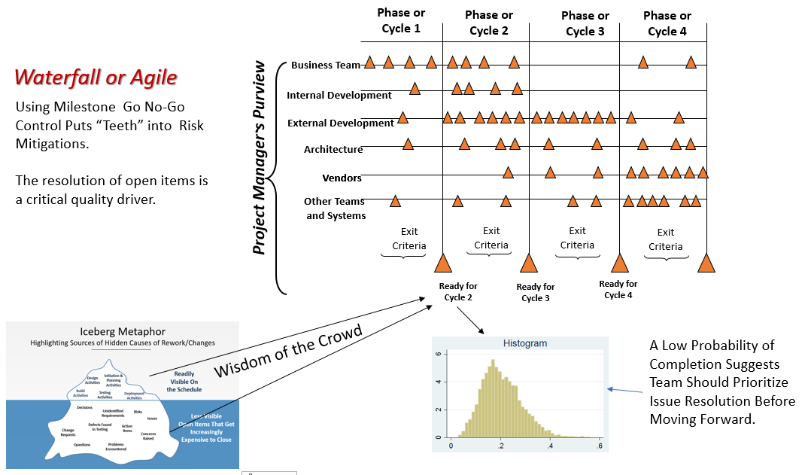
Quality Gate Drivers
Data Science

Slide 54

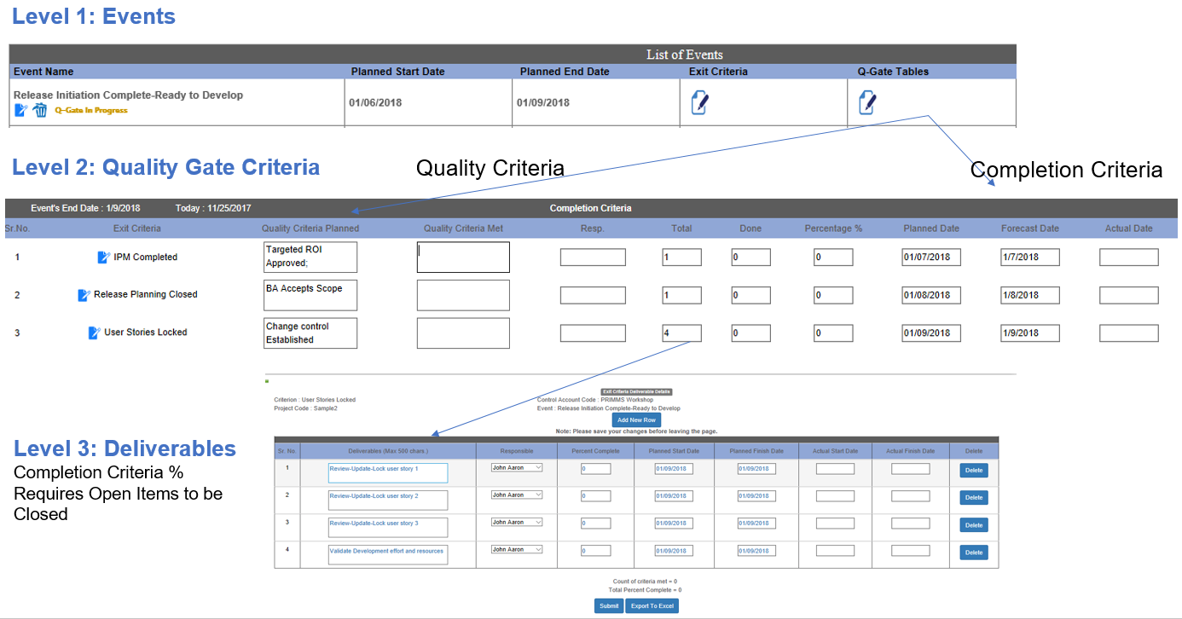
PRIMMS Three Level WBS
Hint: There is an option upload the WBS structure via Excel.

Slide 55
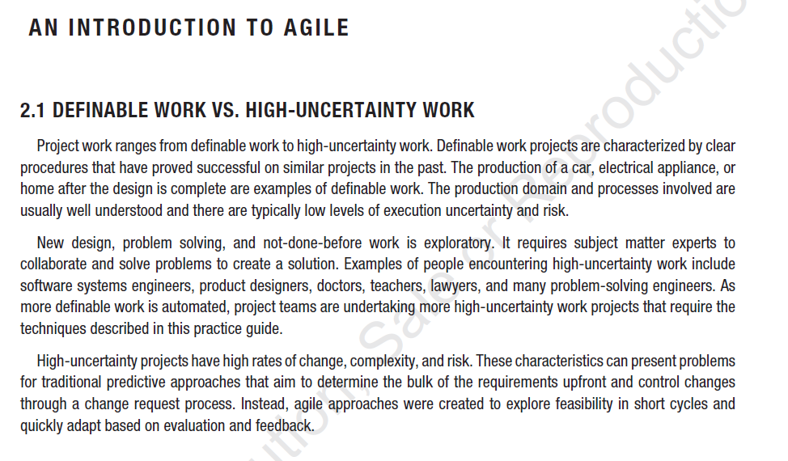

Slide 56
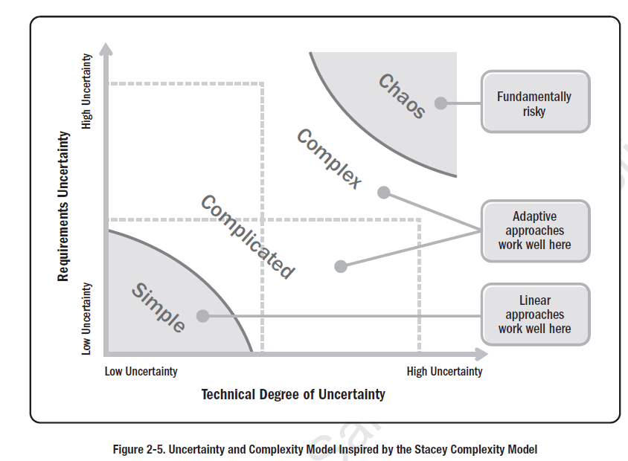

Slide 57
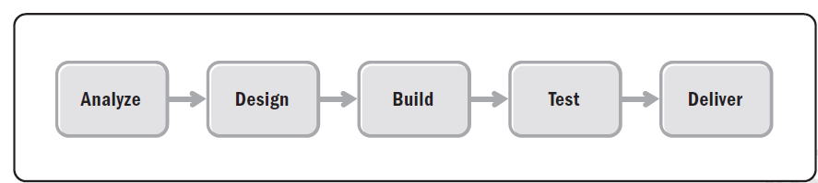

Predictive Life Cycle
Iterative Life cycle

Slide 58



Slide 59
Deliverable 1
Deliverable 2
Deliverable 3
Sprint 1
Sprint 2
Sprint 3

Slide 60


Once the ML Model is Progressively Proven In Value, It is Deployed With Increasing Investment
Deploy Excel Workbooks to Users
Deploy to Server or Cloud
First POC Prototype
User Desktop Only
Second Iteration
Modeling at Desktop Only
Third Iteration
Modeling at Desktop or Cloud
Value From Better
Decision Making In a Function/Process
Value From Better
Decision Making En Masse
Value From Insights

Slide 61
A Revised CRISP-DM Project Methodology with Deliverables
Post Project Monitoring
Project Charter, Value Map and Requirements
Baseline Project Schedule
Business Sign-off and Project Authorization. Scope Change Control
First Baseline Prototype Completed in Dev Environment
Weekly Risk Management Survey—VOT Begins
Issues and Gaps Documented
Phase Exit Review Completed
Weekly Status Begins
Community-Social Media Begins
Deploy Model to PRD
Load/Validate PRD Data
Go Live in PRD
Stabilization
System monitoring
Model Updates
Value Monitoring and
Management
Community Social Media Continues
Second Prototype Completed in Dev Environment
Future State Process Developed with ETL Data Modeled
Future State Process Documented
Schedule Updated
Issues and Defects Captured and Closed
Phase Exit Review Completed
Weekly VOT Continues
Weekly Status Continues
Community Social Media Continues
Third Prototype Created
Test Scripts Created
and Executed in QA
User Acceptance Testing
Completed with full data
Training Scripts Created
User Training Delivered
Issues and Defects Closed
Community Social Media
Continues for communication

Slide 62


Slide 63

The Bank Case Study and Dataset

Slide 64
<----------------------------Value Drivers----------------------->
Improved Competitive
Position
Revenue & Margin Growth
Customer Satisfaction
Employee Satisfaction
Enterprise Value Mapping
Operational Efficiencies
KPI
KPI
KPI
KPI
KPI
Reduced Customer Churn
Marketing
Improved Customer Lifetime Value
5% increased Gross Profit Margins
15% annual revenue growth rate
Sales
Geographic Expansion to EU
20% increase of internet sales
Finance
15% reduction in days outstanding for AR
20 % reduction in inventory costs
30% improvement in On Time Delivery
Operations
15% reduction in quality rejections in work centers
Other

Slide 65

Bank Marketing Example What is the Value at Stake?
Research Indicates an opportunity for 10,000 total customers
$8.5 Mil remaining total opportunity
$1.7 Mil Per Year over five years
-$1,804 average balance
-11.7% Conversion Rate
Marketing Cost=$40 per household to all 40k per year
What is the Value of the project?
45,211 possible customers
5,289 Customers
The question requires us to understand the link between information gain and business value.
$ 1.6 Mil/yr Marketing Cost is Prohibitive
Based Upon Marketing Campaigns To Date

Slide 66

We Run a Simulation as a Thought Experiment
We can now compare how random data predicts actuals.
This gives us insights to the value of going further.

Slide 67


A lift of 1.0 gets us back to the one variable model
This 1 variable model has an accuracy of 80% but extremely low precision (.13) and recall (.12)
Recall=proportion of positive cases correctly identified by the model.
Precision=proportion of predicted positive cases that were correctly classified by the model.
Most interest

Slide 68
By Having a Label (Classification) or a Response Variable (Regression)
We Always Have at Least a One Variable Model Which is the Y Variable Proportion or Mean Value
Minimize the sum of squared errors
Hence, our one variable least squares model is the mean.
So the questions to be answered and scope of our project becomes:
how much value comes from the information gain provided by considering X variables in addition to Y?
If the value is substantial, how do we capture it efficiently?

Slide 69
Bank Marketing Example What is the Value at Stake?
Research Indicates an opportunity for 10,000 total customers
$8.5 Mil remaining total opportunity
$1.7 Mil Per Year over five years
-$1,804 average balance
-11.7% Conversion Rate
Marketing Cost=$40 per household to all 40k per year
Annual Opportunity Cost Due to Lack of Information =
$1.7 Mil X (1/Lift)
$1.7 Mil X 1=$1.7 Mil.
45,211 possible customers
So, in this case going further makes sense. But it does not necessarily have to become a full fledged project at this time. The business case still requires justification.
This also becomes an optimization framework to prioritize projects and allocate time and resources accordingly.

Slide 70



Slide 71



Slide 72
Bank Marketing Example What is the Value at Stake?
Research Indicates an opportunity for 10,000 total customers
$8.5 Mil remaining total opportunity
$1.7 Mil Per Year over five years
-$1,804 average balance
-11.7% Conversion Rate
Marketing Cost=$40 per household to all 40k per year
Annual Opportunity Cost Due to Lack of Information =
$1.7 Mil X (1/Lift)
$1.7 Mil X (1/5.1)=$294k
$1.7 Mil-$294k=$1.4 Mil/year
45,211 possible customers
The Business Case Justifies Going Forward With the Project to Capture the Opportunity if it Can Be Accomplished Efficiently.
Project Management Efficiency
Understanding Variable Importance
Scoring the Model To Prioritize Spending on High Probability Potential Customers
Deploying a Scoring Engine So Multiple Users Can Use the Approach in Day-to-Day

Slide 73
Bank Marketing Example What is the Value at Stake?
Research Indicates an opportunity for 10,000 total customers
$8.5 Mil remaining total opportunity
$1.7 Mil Per Year over five years
-$1,804 average balance
-11.7% Conversion Rate
Marketing Cost=$40 per household to all 40k per year
Annual Opportunity Cost Due to Lack of Information =
$1.7 Mil X (1/Lift)
$1.7 Mil X (1/5.1)=$294k
$1.7 Mil-$294k=$1.4 Mil/year
45,211 possible customers
The Business Case Justifies Going Forward With the Project to Capture the Opportunity if it Can Be Accomplished Efficiently.
Project Management Efficiency
Understanding Variable Importance
Scoring the Model To Prioritize Spending on High Probability Potential Customers
Deploying a Scoring Engine So Multiple Users Can Use the Approach in Day-to-Day Operations

Slide 74
Bank Marketing Example What is the Value at Stake?
Research Indicates an opportunity for 10,000 total customers
$8.5 Mil remaining total opportunity
$1.7 Mil Per Year over five years
-$1,804 average balance
-11.7% Conversion Rate
Marketing Cost=$40 per household to all 40k per year
Annual Opportunity Cost Due to Lack of Information =
$1.7 Mil X (1/Lift)
$1.7 Mil X (1/5.1)=$294k
$1.7 Mil-$294k=$1.4 Mil/year
45,211 possible customers
So, in this case we write a report to provide guidance to management, and we may decide that the opportunity justifies going forward with the project.
This also becomes a framework for prioritization of projects throughout the enterprise and for the optimized allocation of resources.
Project Goal: How to Translate the Lift into Economic Value

Slide 75
We Provide a Project Management Structure

Slide 76
Human and Economic Impact of the Pandemic in the U.S.
106,202 deaths (CDC)
Non-farm payroll employment fell 20.5 million in April (DoL)
Unemployment rate rose to 14.7% (DoL)
Real GDP growth Q1 2020 was -5% (BEA)
The GDPNow model (FRB Atlanta): real GDP growth (seasonally adjusted annual rate) Q2 of 2020 is -52.8 percent
Avoidance of This Cost Justifies Your Project

Slide 77


Slide 78
Appendix

Slide 79

SPM for MAC Users
https://info.salford-systems.com/january-tech-support-cases

Slide 80
The Authors Gloss Over the Phases of Work and Only discuss the Data Science/Machine Learning Deliverables
In Practice Project success Requires More

Slide 81

The Bank Case Study and Dataset—Revenue Growth at an Affordable Cost is the Objective
Description: Assume that This Dataset Contains the Historical Results From a Marketing Campaigns To Obtain New Customers. Create a Marketing Campaign that Maximizes Effectiveness at Minimal Cost.

